Slide 1


Multi-class classification
Neural Networks: Representation
Machine Learning

Slide 2
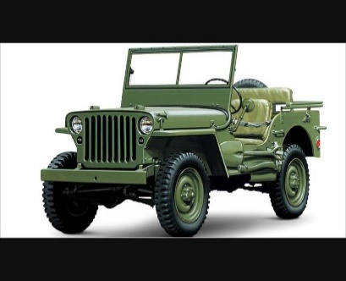
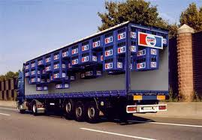

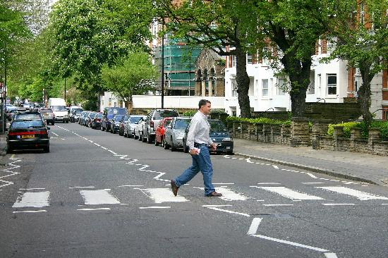
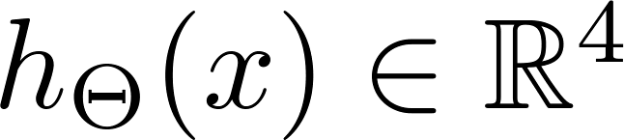
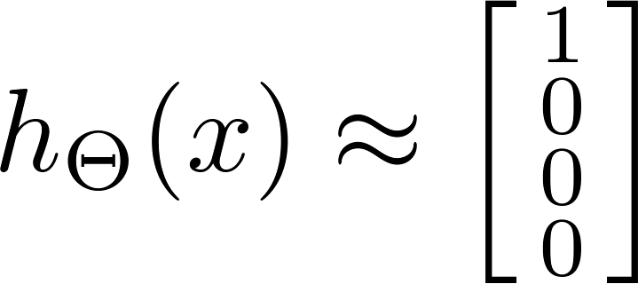

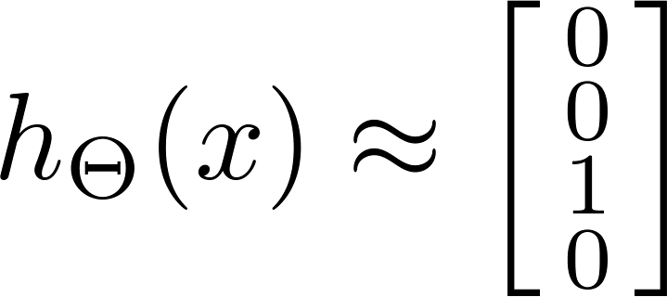
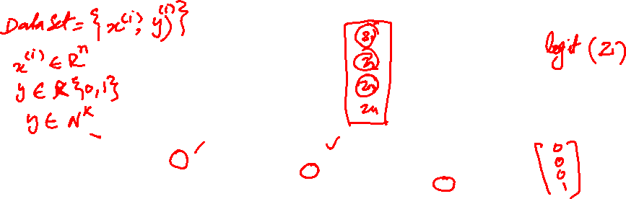
Multiple output units: One-vs-all.
Jeep
Truck
Light
Pedestrian
Want , , , etc.
when jeep when truck when light

Slide 3




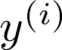
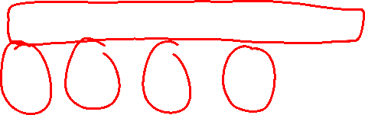
Multiple output units: One-vs-all.
Want , , , etc.
when Jeep when truck when light
Training set:
one of , , ,
Jeep truck light pedestrian

Slide 4
Cost function
Neural Networks: Learning
Machine Learning

Slide 5
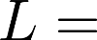
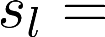
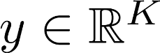
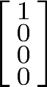
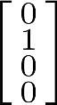
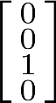

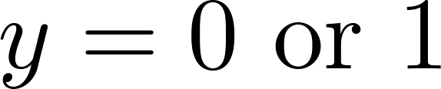
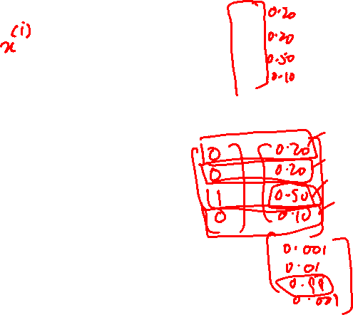

Neural Network (Classification)
total no. of layers in network
no. of units (not counting bias unit) in layer
Layer 1
Layer 2
Layer 3
Layer 4
Binary classification
1 output unit
Multi-class classification (K classes)
K output units
E.g. , , ,
pedestrian car motorcycle truck

Slide 6
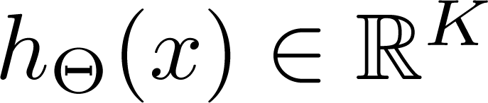
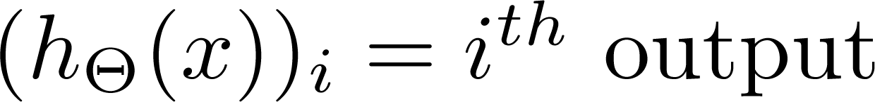
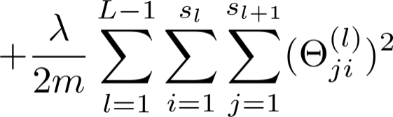
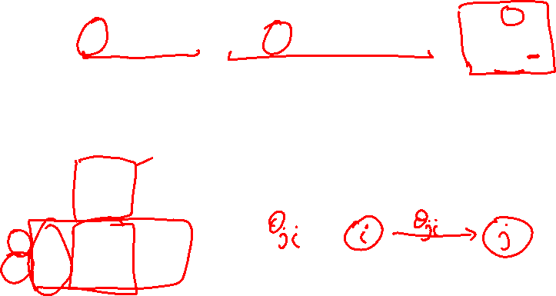
Cost function
Logistic regression:
Neural network:

Slide 7
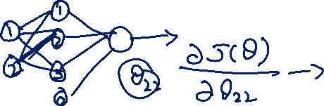
Backpropagation algorithm
Neural Networks: Learning
Machine Learning

Slide 8
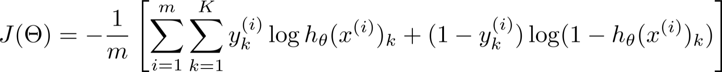
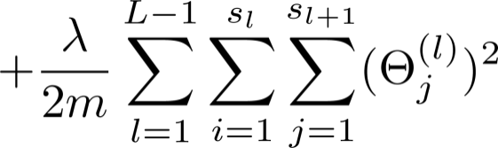
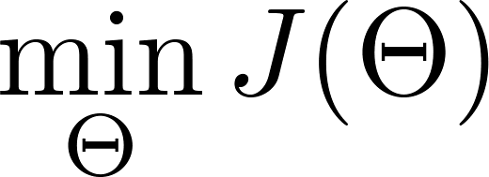
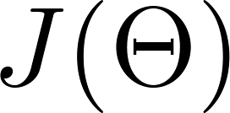
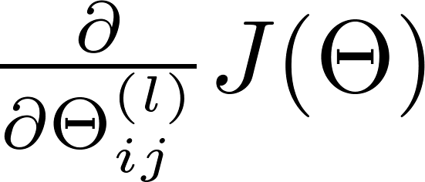
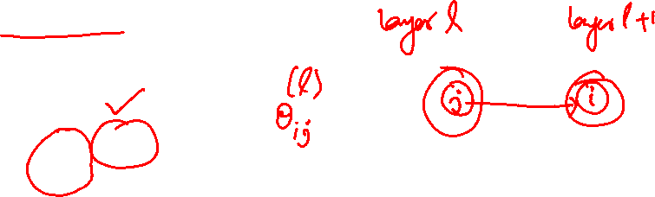
Gradient computation
Need code to compute:

Slide 9


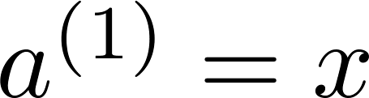
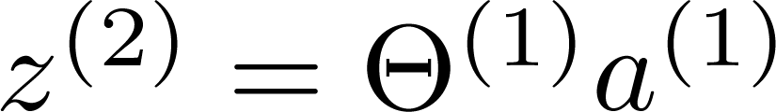
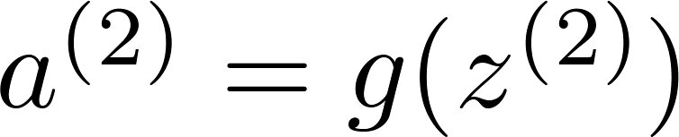
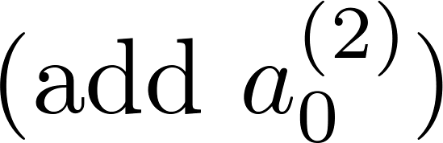
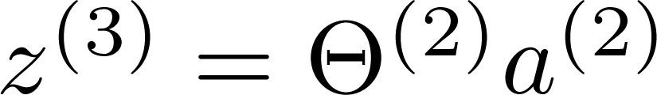
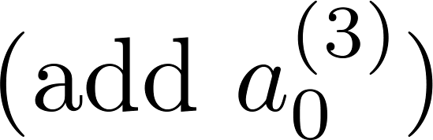
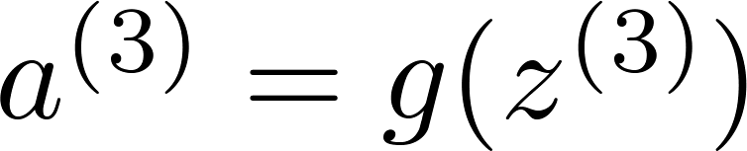
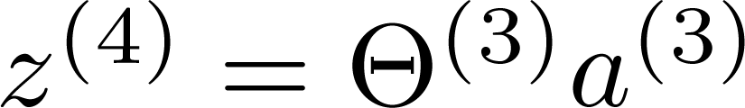
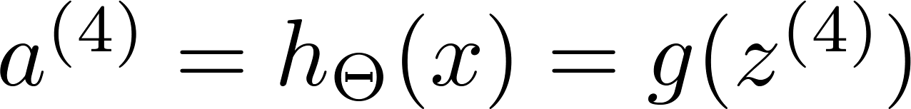
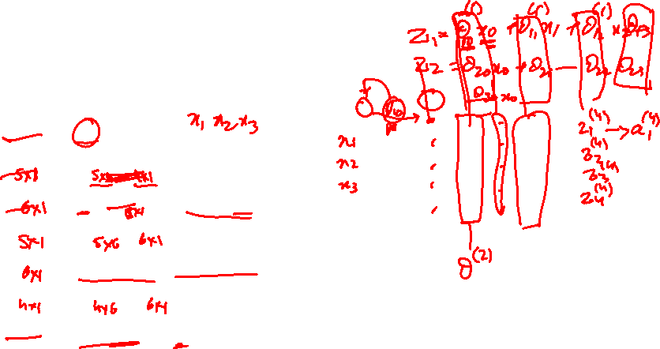

Gradient computation
Given one training example ( , ):
Forward propagation:
Layer 1
Layer 2
Layer 3
Layer 4

Slide 10
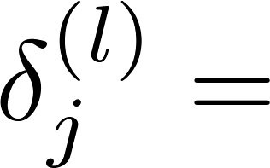

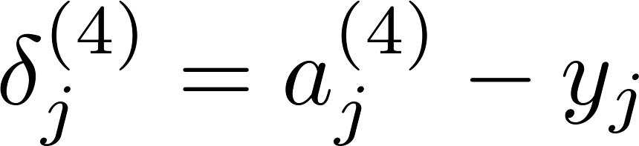
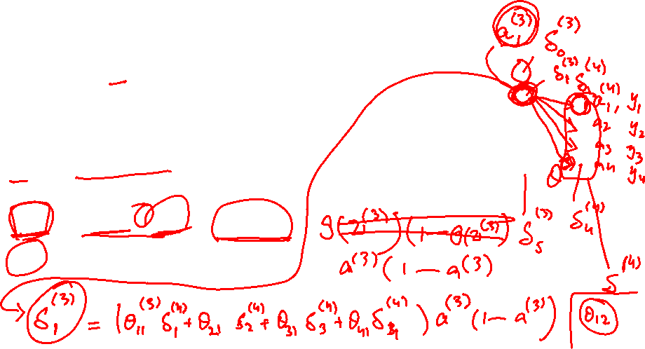
Gradient computation: Backpropagation algorithm
Intuition: “error” of node in layer .
For each output unit (layer L = 4)
Layer 1
Layer 2
Layer 3
Layer 4

Slide 11
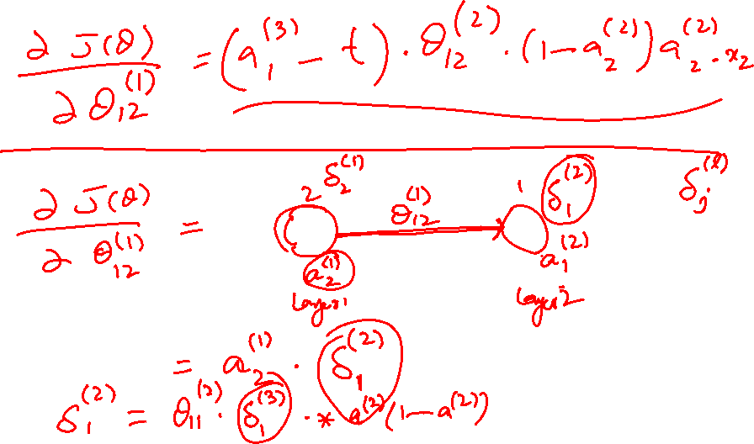

Slide 12
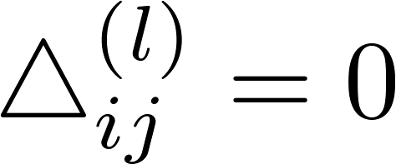
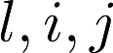
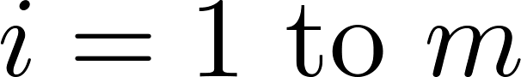
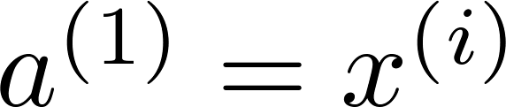
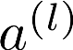
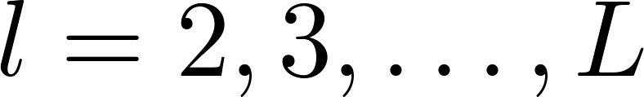
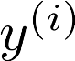
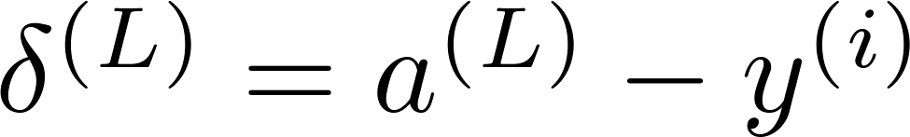







Backpropagation algorithm
Training set
Set (for all ).
For
Set
Perform forward propagation to compute for
Using , compute
Compute

Slide 13
Backpropagation intuition
Neural Networks: Learning
Machine Learning

Slide 14



Forward Propagation

Slide 15
Forward Propagation

Slide 16



What is backpropagation doing?
Focusing on a single example , , the case of 1 output unit, and ignoring regularization ( ),
(Think of )
I.e. how well is the network doing on example i?

Slide 17









Forward Propagation
“error” of cost for (unit in layer ).
Formally, (for ), where

Slide 18
Gradient checking
Neural Networks: Learning
Machine Learning

Slide 19

Numerical estimation of gradients

Slide 20
Numerical estimation of gradients
Implement: gradApprox = (J(theta + EPSILON) – J(theta – EPSILON)) /(2*EPSILON)

Slide 21




Parameter vector
(E.g. is “unrolled” version of )

Slide 22

Implementation Note:
Implement backprop to compute DVec (unrolled ).
Implement numerical gradient check to compute gradApprox.
Make sure they give similar values.
Turn off gradient checking. Using backprop code for learning.
Important:
Be sure to disable your gradient checking code before training your classifier. If you run numerical gradient computation on every iteration of gradient descent (or in the inner loop of costFunction(…))your code will be very slow.

Slide 23
Random initialization
Neural Networks: Learning
Machine Learning

Slide 24





Zero initialization
After each update, parameters corresponding to inputs going into each of two hidden units are identical.

Slide 25
Zero initialization
After each update, parameters corresponding to inputs going into each of two hidden units are identical.

Slide 26
Putting it together
Neural Networks: Learning
Machine Learning

Slide 27
Training a neural network
Pick a network architecture (connectivity pattern between neurons)
No. of input units: Dimension of features
No. output units: Number of classes
Reasonable default: 1 hidden layer, or if >1 hidden layer, have same no. of hidden units in every layer (usually the more the better)

Slide 28






Training a neural network
Randomly initialize weights
Implement forward propagation to get for any
Implement code to compute cost function
Implement backprop to compute partial derivatives
for i = 1:m
Perform forward propagation and backpropagation using example
(Get activations and delta terms for ).

Slide 29

Training a neural network
Use gradient checking to compare computed using backpropagation vs. using numerical estimate of gradient of . Then disable gradient checking code.
Use gradient descent or advanced optimization method with backpropagation to try to minimize as a function of parameters

Slide 30




